Slide 1
ECMAScript Quick Start Day 01
Axle Barr
Bootcamp

Slide 2

AGENDA
Day 1
Review of functions
CommonJS Modules
Example using imports and exports
Arrow (lambda) functions
Var, let, and const
Notes:
Day 1:
Tool: IDE
Conventions
List comprenensions (unique to Python)

Slide 3
Environment Setup
At a Linux terminal run the command, at any folder of your choice:
npm init
Accept all the defaults
In the same folder, touch a js file called index.js, so:
touch index.js
Open index.js in an editor or in the default text editor that comes with Linux.
Add this line just to make sure it works:
console.log(“Hello”);
The index.js file will become the main file for code for the rest of the bootcamp.
Linux + NodeJS + VS Code

Slide 4
Functions Review
function x(){
return "Hi I am function X ";
}
function y(){
return "Hi I am function Y";
}
//
console.log(y);
//console.log(y());
Quick Review of Functions

Slide 5
Functions Review
function x(y){
return "Hi I am function X ";
}
function y(){
return "Hi I am function Y";
}
//
console.log(x);
Quick Review of Functions

Slide 6
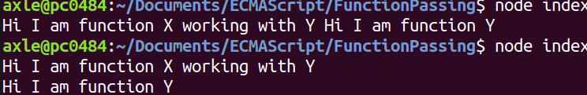
Functions Review
function x(y){
return "Hi I am function X working with Y\n” + y();
}
function y(){
return "Hi I am function Y";
}
//
console.log(x(y));
Quick Review of Functions
Notes:
Graphics:
The image appears on click

Slide 7
Create this class in a file called employee.js
class Employee {
name = "";
department = "";
constructor(name, department) {
this.name = name;
this.department = department;
}
get name() {
return this.name;
}
employeeDetails() {
return this.name + " works in " + this.department;
};
}
CommonJS Modules

Slide 8
Export the class
export class Employee {
name = "";
department = "";
constructor(name, department) {
this.name = name;
this.department = department;
}
get name() {
return this.name;
}
employeeDetails() {
return this.name + " works in " + this.department;
};
}
CommonJS Modules

Slide 9
Import the employee class into index.js
import { Employee } from "./employee.js";
const employee = new Employee("Axle", "IT");
console.log(employee.employeeDetails());
CommonJS Modules

Slide 10
Export the class, alternative
class Employee {
name = "";
department = "";
constructor(name, department) {
this.name = name;
this.department = department;
}
get name() {
return this.name;
}
employeeDetails() {
return this.name + " works in " + this.department;
};
};
export { Employee };
CommonJS Modules
Notes:
No changes in index

Slide 11
Export an object
class Employee {
name = "";
department = "";
constructor(name, department) {
this.name = name;
this.department = department;
}
get name() {
return this.name;
}
employeeDetails() {
return this.name + " works in " + this.department;
};
};
const employee = new Employee("Axle", "Software");
export default employee;
CommonJS Modules

Slide 12
Export an object, then import it in index.js
class Employee {
name = "";
other code here …
};
};
const employee = new Employee("Axle", "Software");
export default employee;
employee.js
CommonJS Modules
import employee from "./employee.js"; console.log(employee.employeeDetails());
index.js

Slide 13
Multiple exports
class Employee {
name = "";
department = "";
constructor(name, department) {
this.name = name;
this.department = department;
}
get name() {
return this.name;
}
employeeDetails() {
return this.name + " works in " + this.department;
};
};
export const colors = ["Orange", "Yellow", "Green"]; export default Employee;
CommonJS Modules

Slide 14
Importing from multiple exports
import Employee, {colors} from "./employee.js";
const e = new Employee("Axle", "Programming");
console.log(e.employeeDetails() + "," + colors[2]);
CommonJS Modules

Slide 15
Real-world Example
At your terminal window, run the following command to install ExpresJS: npm install express
Delete the exployee.js file from the folder but keep it somewhere, we won’t be using it for this example.
After running the command above, you will get a new folder called node_modules, this folder will contain the ExpressJS module that we will import and use
Your package.json file will also change to reflect the installation we just did, but that is not important for this bootcamp

Slide 16
Real-world Example
First import the package
import express from 'express’;
Then create a variable and point it to the express constructor
const app = express();
Now that we have an object, we can use the methods like get()
app.get('/', function(req, res){
res.send('Hello from Skillsoft!’);
});
There is also a listen() method we can use
app.listen(3000, function(){
console.log("Listening on port 3000");
});

Slide 17
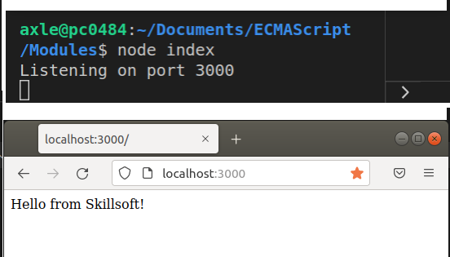
Real-world Example
At the terminal window, run the index file like you did before
Once you get the response “Listening on port 3000” open a browser and navigate to that port

Slide 18
Traditional Functions
const x = function (num1, num2){
return num1 + num2;
}
//
console.log( x(3,5) );
Receive two values via the parameters
Function Expression
Supply two values to the function called x

Slide 19
Function Expression
const x = function (num1, num2){
return num1 + num2;
}
//
console.log( x (3,5) );
Throw (pass) the Values to the Function

Slide 20
Arrow Functions (Lambda Expressions)
const x = (num1, num2) => {return num1 + num2};
//
console.log( x(3,5) );
We can use just one line

Slide 21
Arrow Functions (Lambda Expressions)
const x = (num1, num2) => num1 + num2;
//
console.log( x(3,5) );
No need for return keyword or curly braces

Slide 22
Arrow Functions (Lambda Expressions)
const x = (num1, num2) => num1 + num2;
//
console.log( x(3,5) );
Parameters were passed and => instead of function
function
The same parameters were passed into the function,
just we don’t call it function we call it =>

Slide 23
Arrow Functions (Lambda Expressions)
const x = num1 => num1 + num1;
//
console.log( x(3,5) );
Only one parameter, no need for parenthesis
Also if there is just one parameter, then we don’t need the parenthesis for the parameters

Slide 24
Arrow Functions (Lambda Expressions)
const x = () => 5 + 3;
//
console.log( x(3,5) );
If no parameters, we do need parenthesis
However if there are NO parameters you must indicate this with empty parenthesis

Slide 25
Real-world Example
Delete everything from the folder and paste in the two files from the previous real-world example
Run the command npm install to restore the node_modules folder and other necessary supporting files
Run the index file via node to make sure it works, so node index
If you see the response “listening on port 3000” then the code works like it did before
On the next slide we will transform all the current functions to use arrows instead

Slide 26
Real-world Example
Go from this:
To this:
Finally:
app.get('/', function(req, res){
res.send('Hello from Skillsoft!’); });
app.get('/', (req, res) => {
res.send('Hello from Skillsoft!’); });
app.get('/', (req, res) => res.send('Hello from Skillsoft!’) );

Slide 27
Real-world Example
Go from this:
To this:
app.listen(3000, function(){
console.log("Listening on port 3000");
});
app.listen(3000, () => console.log("Listening on port 3000"));

Slide 28
Variables and Declarations
const num = 5;
var num2 = 6;
let num3 = 7;
function x(){
return "Global variable sum = " + (num + num2 + num3);
}
//
console.log(x())
Three ways to declare and use variables

Slide 29
Variables and Declarations
Using let in different scope:
const num = 5;
var num2 = 6;
let num3 = 7;
function x(){
let num3 = 8;
return "Global variable sum = " + (num + num2 + num3);
}
//
console.log(x())//prints 19
console.log(num3)//prints 7
The let keyword will allow re-assignment, but variable is constrained to { }

Slide 30
Variables and Declarations
Three ways to declare and use variables:
const num = 5;
var num2 = 6;
let num3 = 7;
function x(){
num = 8;//!!error
return "Global variable sum = " + (num + num2 + num3);
}
//
console.log(x())
The const keyword will not allow re-assignment

